Slide 1
TESTING PHASE IN WATERFALL AND AGILE MODEL

Slide 2

WATERFALL MODEL
It is the first Process Model to be introduced.
It is also referred to as a Linear Sequential life cycle model.
In waterfall model, each phase must be completed before the next phase can begin and there is no overlapping in the phases.

Slide 3
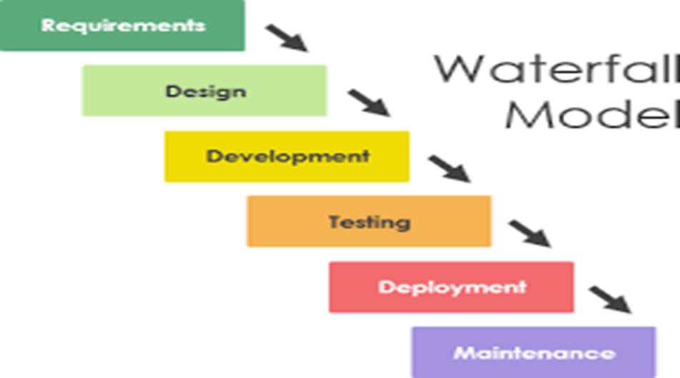
Requirements are gathered which would be told by the client(It will tell us that whether it wants it in android, ios ) and will be discussed with the team. On the basis of the client requirements from the previous phase the senior members of the project team design the architecture. Team works on coding the project like which language can be used. Testing team tests the complete application and identifies any defects in the application and they are fixed by the developers and the team builds and installs the application on the servers Team ensures that the application is running smoothly on the servers without any downtime.

Slide 4
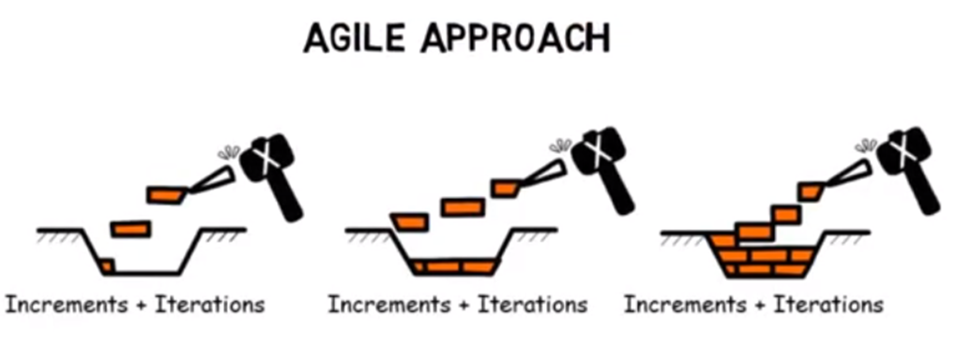
AGILE MODEL
The term AGILE means the ability to respond to changes-
changes from requirements, technology, people.
It is a iterative and a incremental process.
The Role of Testers in an Agile Environment:
1) Attend sprint-planning sessions
2) Attend daily stand-ups.
3) Don’t save all the testing for the end; test throughout the sprint.
4) Meet with developers for short hand-off demonstrations

Slide 5
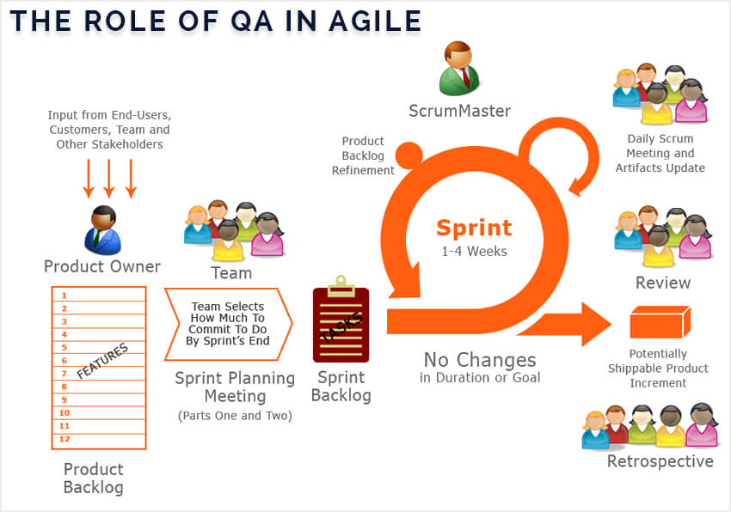
Agile testing involves testing from a customer point of view and performed as early as possible. Agile Scrum is the most commonly used agile method. The role of a software tester in an Agile Scrum Process is not just testing the software and finding defects but extends to many other things. An agile software tester works with the development team, product owner and every part of the team to make the product on a fast pace

Slide 6
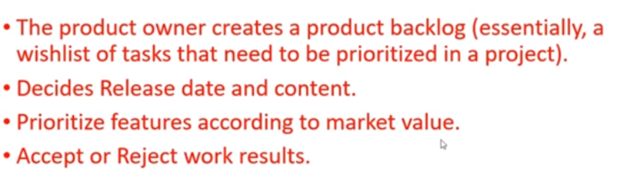
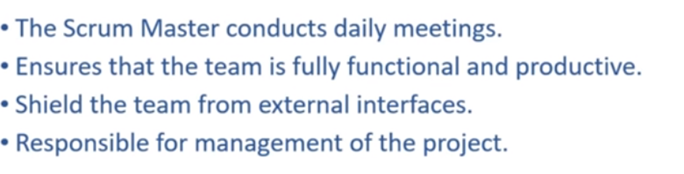
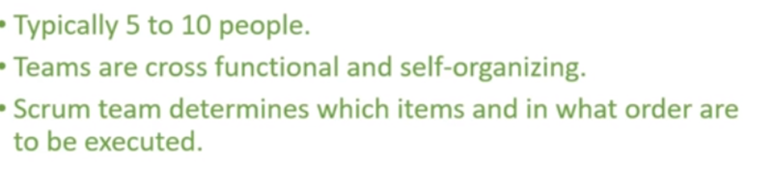
ROLES OF SCRUM: 1.Product Owner 2.Scrum Master 3.Scrum Team

Slide 7
Thank You

